Slide 1
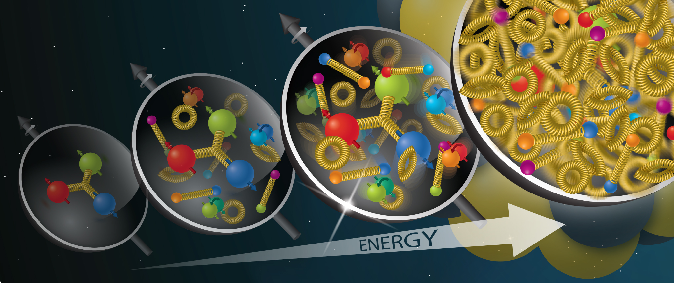
Understanding QCD dynamics through p-Pb collisions at the LHC
Allencris J.R.R.
Supervisor: Prof. Ronan McNulty
Image Credit: “Brookhaven Lab to Lead New 'Saturated Glue' Theory Collaboration“ , Brookhaven National Laboratory, 2022. https://www.bnl.gov/newsroom/news.php?a=120965
Notes:
Brief overview of end goal. Ie. Gluon saturation has not been seen definitively but should manifest in suppressed cross-sections.
1

Slide 2
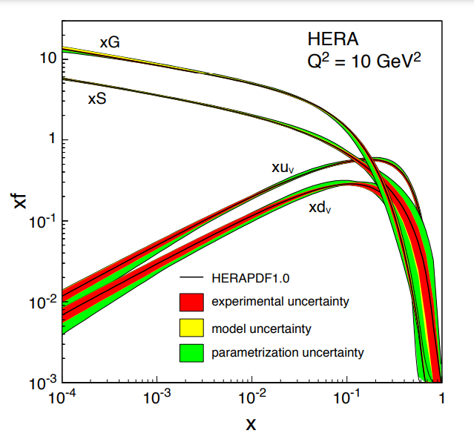
Fig1. Proton parton distribution functions plotted as a function of Bjorken x
(Acardi et al., 2012)

Slide 3
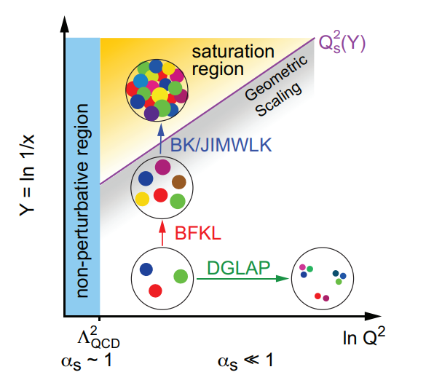
Fig2. A map plotting the log of against . Different Evolution equations govern different regimes
(Acardi et al., 2012)

Slide 4
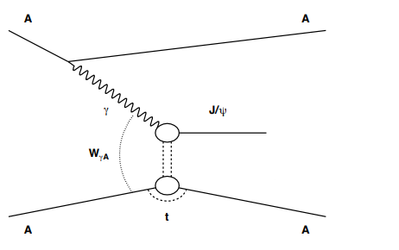
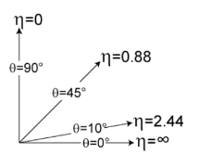
Introduction
Cross-section:
Probability that a given process takes place
Vector Mesons:
Bound states of with the quantum numbers
Central Exclusive Production:
Class of reactions
A & B remain intact. X is fully measured
Fig3. CEP of the meson in an ion-ion collision. Phys. Rev. C97 (2018) 024901
Rapidity (y) :
Measure of particle angle with respect to beam axis
for UR
Pseudorapidity () :
Rapidity but easier to measure
Fig4. Pseudorapidity range
(Albrow et al, 2010)
Notes:
Get people familiar with basic vocab of project. Show them what CEP looks like diagrammatically
4

Slide 5
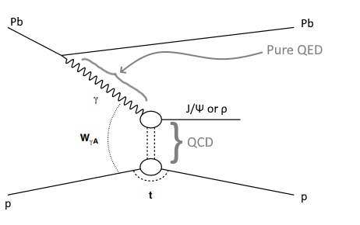
Fig5. The particular process(es) we’re interested in.
Notes:
Describe physical process being used in investigation. CEP produces no junk as the particles don’t interact hadronically. Useful for clean signals and simplified analysis.
5

Slide 6
Overview of Project Goals
Weizsacker-Williams Approximation
Equivalent photon spectrum
Photoproduction cross-section
Color-dipole formalism
(Goncalves et al, 2017)

Slide 7
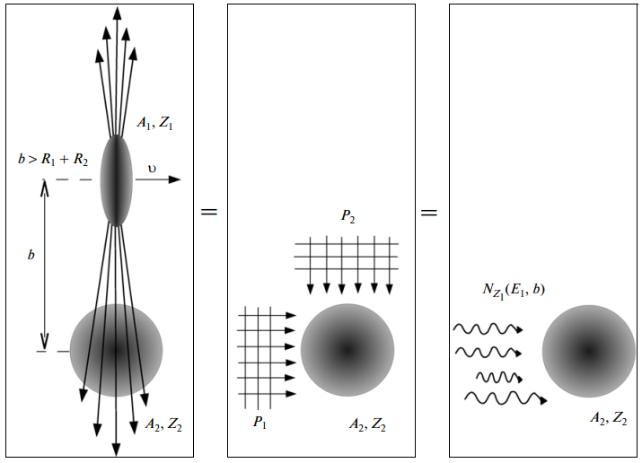
Equivalent Photon Approximation (EPA)
1. Compute E-field of in rest frame of
2. Fourier transform
3. and
4. Integrate over impact parameter to get
Fig6. Diagram showing equivalence of the E-field and a flux of photons
(Pshenichnov, 2011)
(Fermi, 1924)
(Williams, 1935)

Slide 8
Color-dipole formalism
Photons fluctuate into a (colourless)
This interacts with the nucleus through strong force
Light Vector Meson
=
Regge Theory
Heavy Vector Meson
=
pQCD
Exchange of colour singlet gluon system (2 gluons)
(Goncalves et al, 2002)

Slide 9
References
[1] A. Accardi et al. Electron Ion Collider: The Next QCD Frontier - Understanding the glue that binds us all. 2012. DOI: 10. 48550/ARXIV.1212.1701. URL: https://arxiv.org/abs/1212.1701.
[2] M.G. Albrow, T.D. Coughlin, and J.R. Forshaw. “Central exclusive particle production at high energy hadron colliders”. In: Progress in Particle and Nuclear Physics 65.2 (2010), pp. 149–184. DOI: 10.1016/j.ppnp.2010.06.001. URL: https: //doi.org/10.1016%2Fj.ppnp.2010.06.001.
[3] Carlos A. Bertulani, Spencer R. Klein, and Joakim Nystrand. “PHYSICS OF ULTRA-PERIPHERAL NUCLEAR COLLISIONS”. In: Annual Review of Nuclear and Particle Science 55.1 (2005), pp. 271–310. DOI: 10.1146/annurev.nucl. 55.090704.151526. URL: https://doi.org/10.1146%2Fannurev.nucl.55.090704.151526.
[4] Enrico Fermi. “On the Theory of Collisions between Atoms and Electrically Charged Particles”. In: Electromagnetic Probes of Fundamental Physics. WORLD SCIENTIFIC, 2003. DOI: 10.1142/9789812704214_0026. URL: https://doi.org/ 10.1142%2F9789812704214_0026.
[5] V. P. Gonc¸ alves and C. A. Bertulani. “Peripheral heavy ion collisions as a probe of the nuclear gluon distribution”. In: Physical Review C 65.5 (2002). DOI: 10.1103/physrevc.65.054905. URL: https://doi.org/10.1103%2Fphysrevc. 65.054905.
[6] V. P. Gonc¸alves and M. V. T. Machado. “Nuclear exclusive vector meson photoproduction”. In: The European Physical Journal C 38.3 (2004), pp. 319–328. DOI: 10.1140/epjc/s2004-02044-7. URL: https://doi.org/10.1140%2Fepjc% 2Fs2004-02044-7.
[7] V. P. Gonc¸alves et al. “Color dipole predictions for the exclusive vector meson photoproduction in pp/pP b/P bP b collisions at run 2 LHC energies”. In: Physical Review D 96.9 (2017). DOI: 10 . 1103 / physrevd . 96 . 094027. URL: https : //doi.org/10.1103%2Fphysrevd.96.094027.
[8] Spencer R. Klein et al. “STARlight: A Monte Carlo simulation program for ultra-peripheral collisions of relativistic ions”. In: Computer Physics Communications 212 (2017), pp. 258–268. DOI: 10 . 1016 / j . cpc . 2016 . 10 . 016. URL: https : //doi.org/10.1016%2Fj.cpc.2016.10.016.
[9] I. A. Pshenichnov. “Electromagnetic excitation and fragmentation of ultrarelativistic nuclei”. In: Phys. Part. Nucl. 42 (2011), pp. 215–250. DOI: 10.1134/S1063779611020067.
[10] E. J. Williams. “Correlation of certain collision problems with radiation theory”. In: Kong. Dan. Vid. Sel. Mat. Fys. Med. 13N4.4 (1935), pp. 1–50.

